Slide 1
Hydro Electric Power System
HEPS
HEPS in Nepal

Slide 2
What is HPS?
A system generating mechanical or electrical power from hydro power.

Slide 3
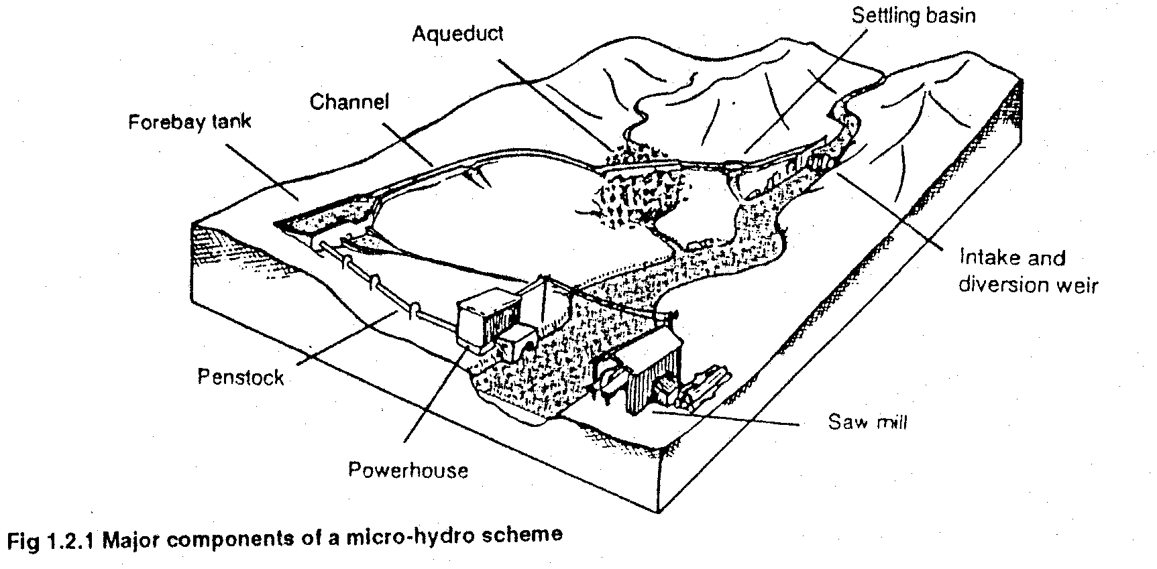
Components of scheme:

Slide 4
Components of scheme: contd.
Hydrology and site survey
Civil Components
Hydro mechanical Components
Electro mechanical Components
Electrical Components

Slide 5
Chapter TWO
Hydroelectric power plants

Slide 6
Introduction
The purpose of a hydroelectric power plant is to harness power from water flowing under pressure. As such it incorporates a number of water driven prime-movers known as water turbines.
Water flowing under pressure has two forms of energy kinetic and potential. The kinetic energy depends on the mass of water flowing and its velocity while the potential energy exists as result of the difference in water level between two points which is known as "head". The water or hydraulic turbine, as it is sometimes named, converts the kinetic and potential energies possessed by water into mechanical power.

Slide 7
Head and flow rate or discharge
Head is the difference in elevation between two levels of water. The head of a hydroelectric power plant is entirely dependent on the topographical conditions.
Head can be characterized as: gross head, and net or effective head.

Slide 8
Gross head
Is defined as the difference in elevation between the head race level at the intake and the tail race level at the discharge side, naturally, both the elevations have to be measured simultaneously. The gross head may vary as both the elevations of water do not remain the same at all times. It is essential to known the maximum and minimum as well as the normal values of the gross head. The normal value would be that for which the plant works most of the time. In rainy season the flood may raise the elevation of tail race, thus, reducing the gross head. On the other hand at the time of draught the same may be increased.

Slide 9
Net head
Is the head obtained by subtracting from gross head all losses in carrying water from the head race to the entrance of the turbine. The losses are due to friction occurring in tunnels, canals and penstocks which lead the water into the turbine. Net or effective head is, therefore, the true pressure difference between the entrance to the turbine casing and the tail race water elevation.
Flow rate or discharge of water:
It is the quantities of water used by the water turbine in unit time and is generally measured in (m3/s) or ( l/s).

Slide 10
What is fluid energy?
A total energy in the fluid (hydro) is constant unless external energy is added or extracted from the system.The energy in the system is expressed in terms of pressure energy, velocity energy and elevation energy – Bernoulli’s theorem
p/ρg + v²/2g + z = constant

Slide 11
Important Term of HEPS
Grosss head
Difference in level between the head race at intake and discharge side of tail race
Measured simultaneously
Vary because elevation of water level vary
Change in dry (draught) and rainy season
Indicate max, mini and normal (most time of YR.)

Slide 12
Net or effective head:
Gross head – ( all loses in carrying water from head race to entrance of turbine)
Or the head difference between entrance and exit of the turbine
It is due to the losses on the way and loss of head at the tail race + exit.

Slide 13
Flow rate or Discharge:
Quantity of water used by the turbine in unit time
l/s or m³/s

Slide 14
What is the HP potential and geography of Nepal?
Nepal located on the lap of mighty Himalayas between India & China
Population around 24 million
Area 147, 181 sq.km & politically divided into 14 zones & 75 districts
Most part of the country mountainous and rugged

Slide 15
Nepal HPS contd.
Extension of National Grid System every where is very difficult
To date only 730 MW of hydropower
Nepal rich in hydropower resources

Slide 16
Nepal HPS contd.
Estimated potential 83, 000 MW
Economically exploitable 43,000 MW
Six thousand rivers and rivulets
many glacier-fed rivers
Water, natural bounty of Himalayas
Multi-pronged strategy to develop large hydropower

Slide 17
Present categorization of HP schemes:
- less than 1000 kW : Mini-micro
- from 1000 kW to 10 MW: Small hydro
- from 10 MW to 300MW: Medium hydro
- plants above 300 MW: Big hydro

Slide 18
Essential Component of HEPS:
Storage reservoir
Dam with control works
Water way with controls
Power house
Tailrace
Generation and Transmission of EL/ power

Slide 19
Storage reservoir:
Water available in catchment area is stored for uniform and according to requirement
Natural R: lake in high mountains
Artificial R: dame and reservoir
Dam:
It is a structure erected on the source for storage , creating head and cntrol flow
Types: earth masonry, wood. Steel concrete.

Slide 20
Control works:
Trash Rack
Obstruct debris from going into intake
Made up of rows of steel bars placed across entire intake opening in inclined position
Heating elements

Slide 21
Water way with controls:
It is a passage through which water is carried from the storage reservoir to the turbine.
It consists of tunnel, channel, Foreby, penstock, different types of gate and valve etc.

Slide 22
Forebays,Valves:
Before start of penstock smaller reservoirs known as forebays or surge tank.
The forebays distri­bute the water to penstocks through which it is lead to the turbines.
These forebays help to regulate the demand of water according to the load preventing sudden change of pressure.
Valve before penstock controls the flow and facility for cleaning and repair.

Slide 23
Power house:
It is a house containing turbines, generators and other operating mechanism.
Tailrace:
It is a house containing turbines, generators and other operating mechanism.
Generation and Transmission of EL/ power:
It contains generators, transformers, switches, transmission wires.

Slide 24
Classification of HEPP
(a) The head under which they work-High head, low head and medium head plants.
(b) Their functions - Run off river plants, storage plants and pumped storage plants.
(c) The load capacity-Base load plants and peak load plants.
(d) The source of energy-River (or reservoir) power plants and tidal
power plants.

Slide 25
High Head Water Plants
Such plants work under heads ranging from 100 to 2,000 m.
Water is usually stored up in lakes on high mountains during the rainy season or during the season when the snow melts.
The rate of flow should be such that water can last through­out the year.

Slide 26
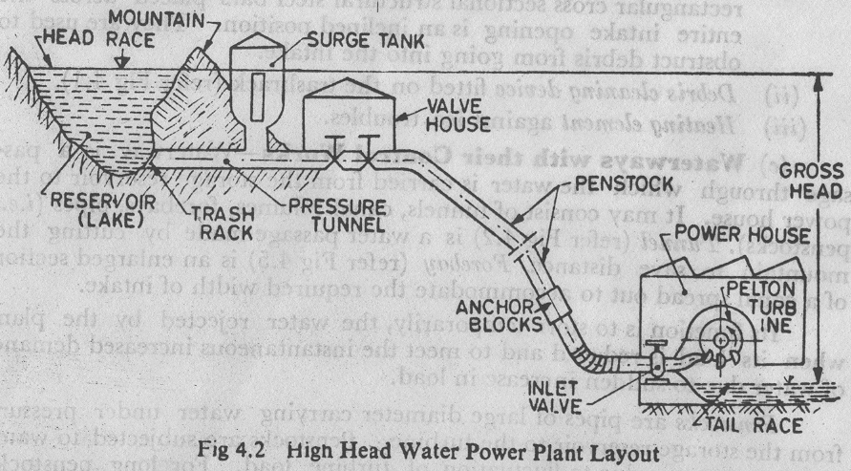
High Head Water Plants contd.
High Head Water Power Plant Layout

Slide 27
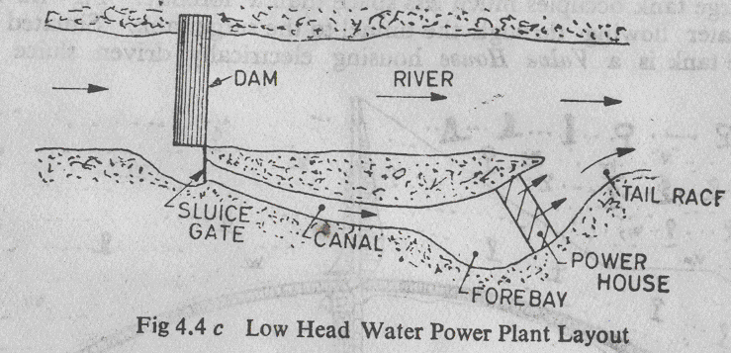
Low Head Water Power Plants:
Such plants work under heads ranging less than 50 m.
These plants usually consist of a dam across a river.
A sideway stream diverges from the river at the dam.
Channel, forebay, power house and tailrace etc.

Slide 28
Channel Water Power Plant:
This is low head plants. If there is a river having a bend whose level A is higher than at B, a straight is constructed.
A dam near diverts the water into the channel. The main sluice gates are erected near A to control the rate of low of water into the canal as well as the forebay.
The power house is shown on the right hand side of the forebay.
On leaving the turbines, installed in the power house, the water is lead back into the river by the canal at B.

Slide 29
Channel Water Power Plant- contd.
When the turbine load decreases and there is less demand for water by the turbines, the excess flow instead of swelling the canal is diverted over the waste weir into the river, thus by-passing the turbines. A drain gate on the side of waste weir facilitates cleaning and repairing of canal.

Slide 30
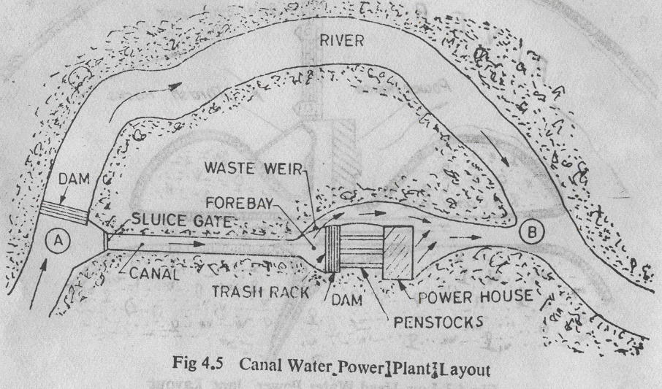
Channel Water Power Plant- contd.

Slide 31
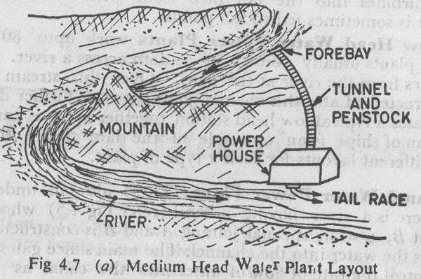
Medium Head Water Power Plant:
Such plants work under heads ranging from 50m to 100 m.

Slide 32
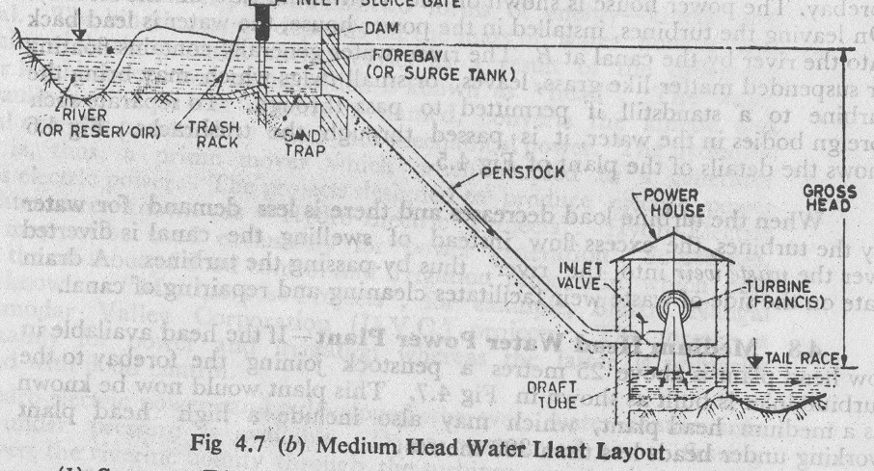
Medium Head Water Power Plant:

Slide 33
Run of The river plants:
It does not store any water and uses the water as it flows in the river.
Run-off-river plants may be without water pond or with water pond. The plants with pondage are provided with a weir or barrage to accommodate sufficient storage to take care of load fluctuations.
It is generally base load plant.

Slide 34
Storage Plant:
It has storage reservoir provided by constructing a dam across the river if the plant is low head or by closing the opening of a valley by a dam in case of a high head plant.
It is useful for fluctuations of water supply during flood and draught periods, as well as load fluctuations, thus increasing the utility of plant.
Such a plant is also useful as peak load plant.

Slide 35
Pumped Storage Plant:
It stores power by pumping back a portion of water from the tail race back to the reservoir during off-peak hours, when excess power can be available for this purpose.
The pumping is done by the same turbine-generator (producing power) which now acts as a pump as turbine.
In certain cases where it is not possible to use PAT, a separate pump is coupled to the same shrift.

Slide 36
Base-load Plant:
It is used to take load of the system.
Such plants are required to supply a constant power when connect to the grid.
Thus they run without stop and are often remote-controlled with which least staff is required for such plants. Run-of-the -river plants without pond may sometimes work as base load plants.

Slide 37
Peak-load Plants:
It supply the power during peak loads. And Some of such plants supply the power during average load also.
The run-of-the-river plants may be made for the peak load by providing pondage.

